Slide 1


DataBase Logic in Business Applications
Al.I. Cuza University of Iași
Faculty of Economics and Business Administration
Department of Accounting, Information Systems
and Statistics
PL/SQL Collections
By Marin Fotache & Co.

Slide 2
Collections in Oracle
Collections are a fundamental programming ingredient
In Oracle, there are three types of collections
Associative arrays (index-by tables)
Nested tables
Variable-length arrays (varrays)
All of them can be used in PL/SQL blocks
Only the last two can be used for defining persistent types that can be used in object and or table definition (see next slide)
Can be used also for loading multiple records from tables (bulk processing)

Slide 3
Types of Oracle Collections
Collection type | Number of Elements | Subscript Type | Dense or Sparse | Where Created | Can Be Object Type Attribute
Associative array (or index-by table) | Unbounded | String or integer | Either | Only in PL/SQL block | No
Nested table | Unbounded | Integer | Starts dense, can become sparse | Either in PL/SQL block or at schema level | Yes
Variable-size array (varray) | Bounded | Integer | Always dense | Either in PL/SQL block or at schema level | Yes

Slide 4
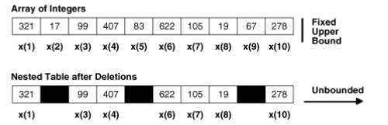

Collection storage (in memory)

Slide 5
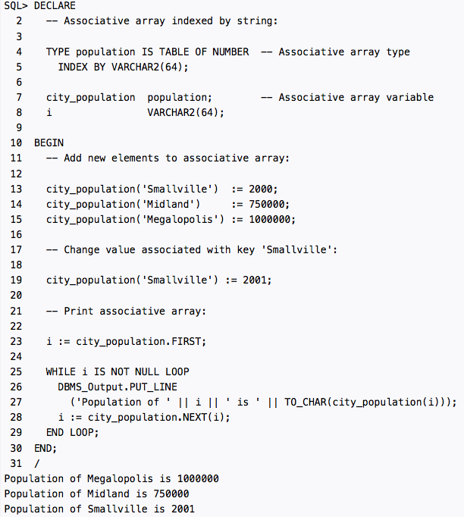
Associative Arrays (1)

Slide 6
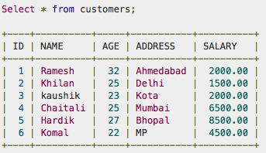
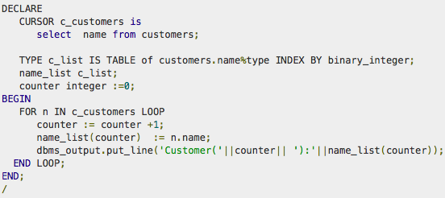
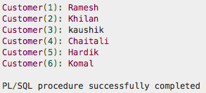
Associative Arrays (2)
http://www.tutorialspoint.com

Slide 7
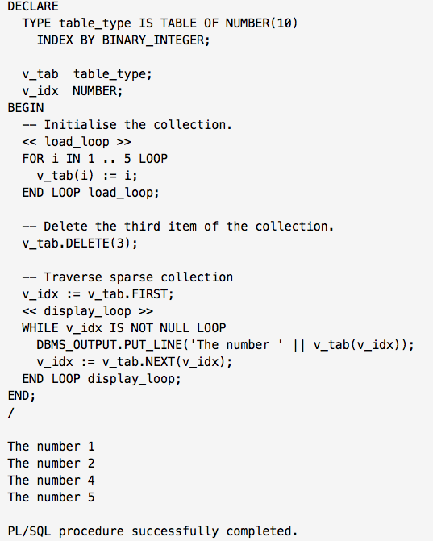
Associative Arrays (3)
https://oracle-base.com

Slide 8
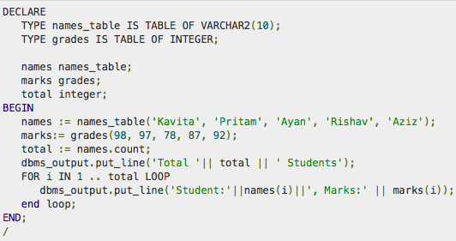
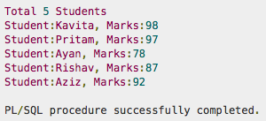
Nested Table (1)
http://www.tutorialspoint.com

Slide 9
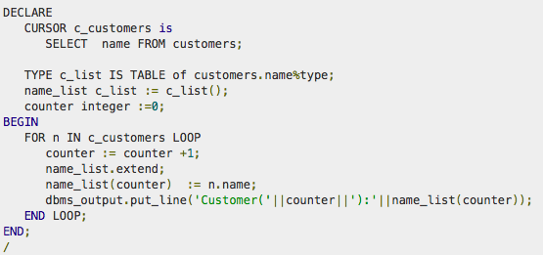
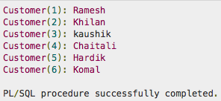
Nested Table (2)
http://www.tutorialspoint.com

Slide 10
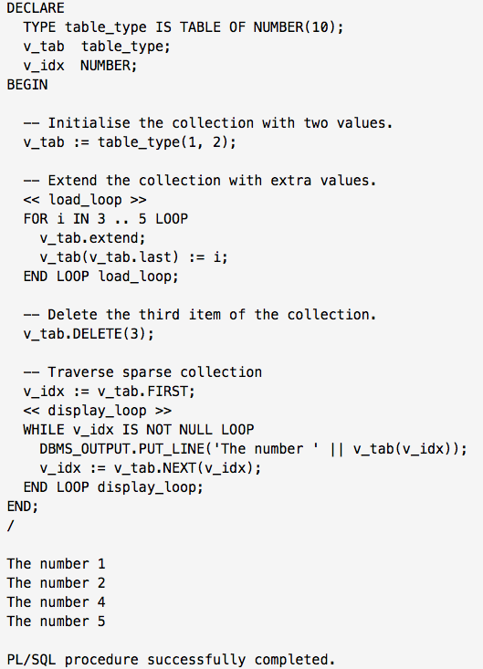
Nested Table (3)
https://oracle-base.com

Slide 11
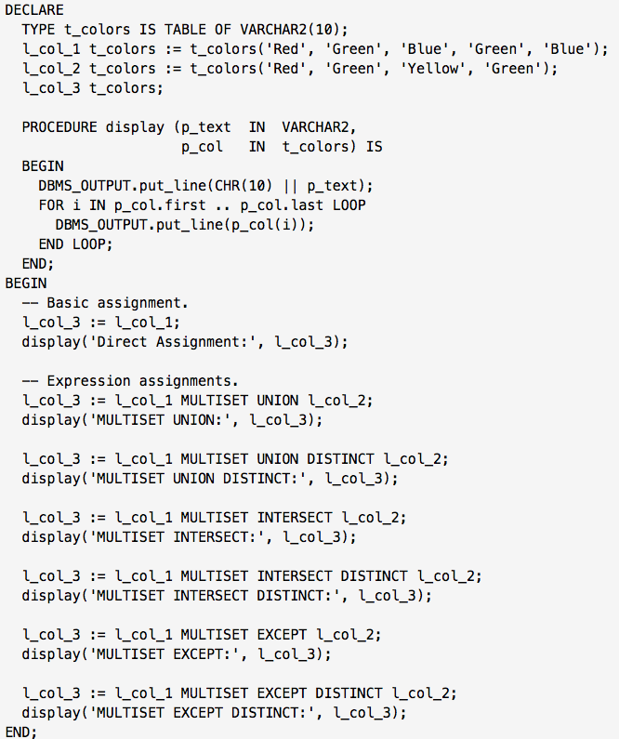
Nested Table (4)
https://oracle-base.com/articles/10g/plsql-enhancements-10g#nested_table_enhancements

Slide 12
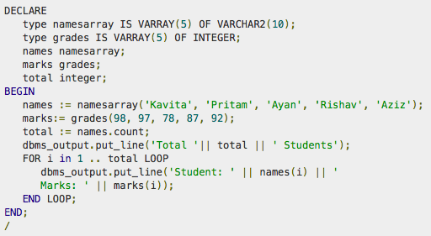
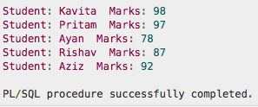
Varray (1)
http://www.tutorialspoint.com

Slide 13
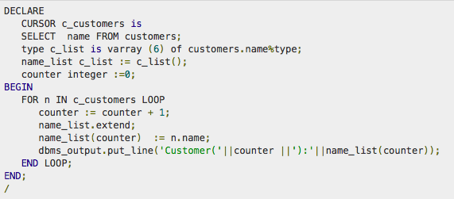
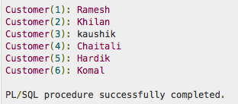
Varray (2)
http://www.tutorialspoint.com

Slide 14
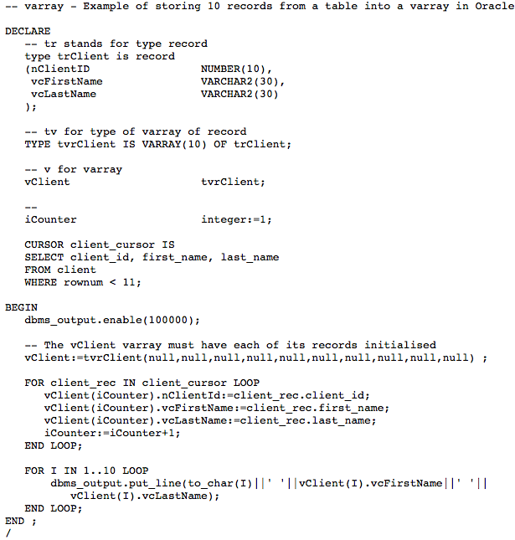
Varray (3)
http://www.dbstar.com

Slide 15
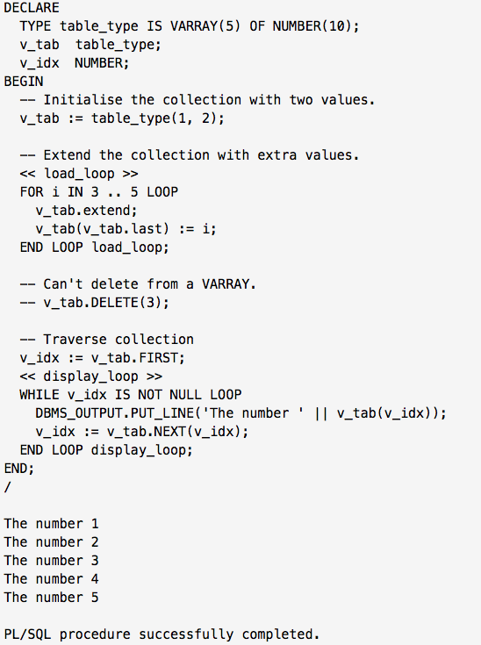
Varray (4)
https://oracle-base.com

Slide 16
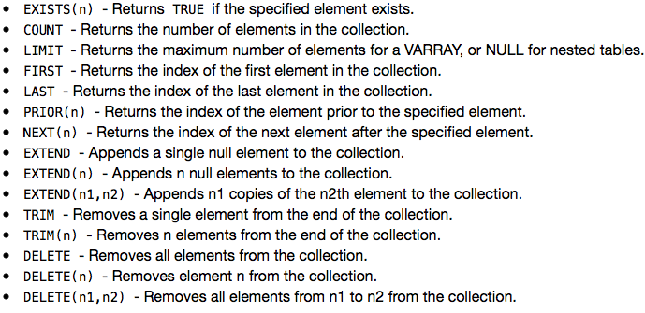
Main Collection Methods

Slide 17
Useful Resources on Oracle Collections
PL/SQL Tutorial (TutorialsPoint)
http://www.tutorialspoint.com/plsql/plsql_collections.htm
Steven Feuerstein - Working with Collections, Oracle Magazine, July/August 2012, http://www.oracle.com/technetwork/issue-archive/2012/12-jul/o42plsql-1653077.html
Steven Feuerstein - Bulk Processing with BULK COLLECT and FORALL, September/October 2012
http://www.oracle.com/technetwork/issue-archive/2012/12-sep/o52plsql-1709862.html
Using PL/SQL Collections and Records
https://docs.oracle.com/cd/B28359_01/appdev.111/b28370/collections.htm

Slide 18
Useful Resources on Oracle Collections (cont.)
sandip_bhadane - Oracle PL/SQL collections
http://www.codeproject.com/Articles/164705/Oracle-PL-SQL-collections
Purpose of using different types of PL/SQL collections in Oracle
http://stackoverflow.com/questions/14934514/purpose-of-using-different-types-of-pl-sql-collections-in-oracle

Slide 19
Video-tutorials on Oracle Collections
Steven Feuerstein Oracle PL/SQL Best Practices: Bulk Processing
https://www.youtube.com/watch?v=Zdpw9z05LWQ&index=87&list=PLmeVq-LGlaQ0_-X63joXw22VDDAafekGZ&spfreload=10
BULK COLLECT and FORALL-A PL/SQL Performance Booster
https://www.youtube.com/watch?v=o_LGVrl-a3w&index=113&list=PLmeVq-LGlaQ0_-X63joXw22VDDAafekGZ
PL/SQL Oracle BULK COLLECT tutorial
https://www.youtube.com/watch?v=oEUINI-GYU4&index=29&list=PLmeVq-LGlaQ0_-X63joXw22VDDAafekGZ

Slide 20
Video-tutorials on Oracle Collections (cont.)
See also video-tutorials from the playlist:
https://www.youtube.com/playlist?list=PL3245012E0631F7AE&spfreload=10
PLS-16: PL/SQL Index By Table
PLS 15 PL SQL Nested Table (not in the playlist) https://www.youtube.com/watch?v=RFOEniVWU_Q&spfreload=10
PLS-14: Pl/SQL VARRAY Composite Data Type
PLS-12: PL/SQL Bulk Collect and Bulk Bind

Slide 21
Text (in Romanian)
https://github.com/marinfotache/Database-Logic-in-Business-Applications/blob/master/Oracle%209i2.%20Ghidul%20dezvoltarii%20aplicatiilor%202003/Cap08_PL_SQL1/Oracle_Cap08_PL_SQL1.pdf (section 8.6)
https://github.com/marinfotache/Database-Logic-in-Business-Applications/blob/master/Oracle%209i2.%20Ghidul%20dezvoltarii%20aplicatiilor%202003/Cap09_PL_SQL2/Oracle_Cap09_PL_SQL2.pdf (sections 9.3-9.5)

